Slide 1
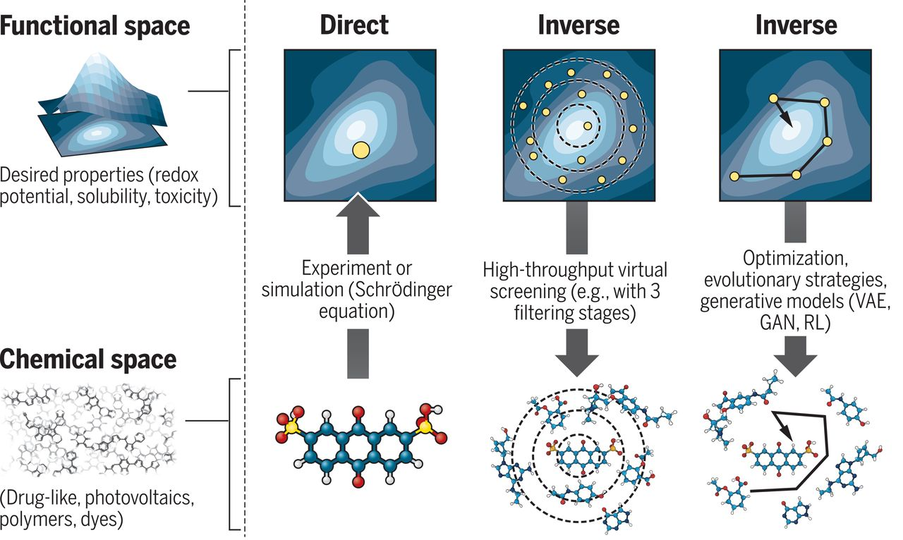
Evolutionary strategies for molecular design

Slide 2

Materials Science
Think of just about any major challenge we face and materials are at the center of it.
To build a new clean energy future, we need more-efficient solar panels, wind turbines, and batteries.
Manufacturers need new materials to create more advanced products.
We also need to replace materials subject to supply disruptions, such as rare earth elements.
Yet today, we’re in the midst of a materials revolution. Powerful simulation techniques, combined with increased computing power and machine learning, are enabling researchers to automate much of the discovery process, vastly accelerating the development of new materials, in some cases by a factor of more than a hundred.
https://www.barrons.com/articles/the-trillion-dollar-potential-in-crispr-materials-science-and-quantum-computing-51550412044

Slide 3
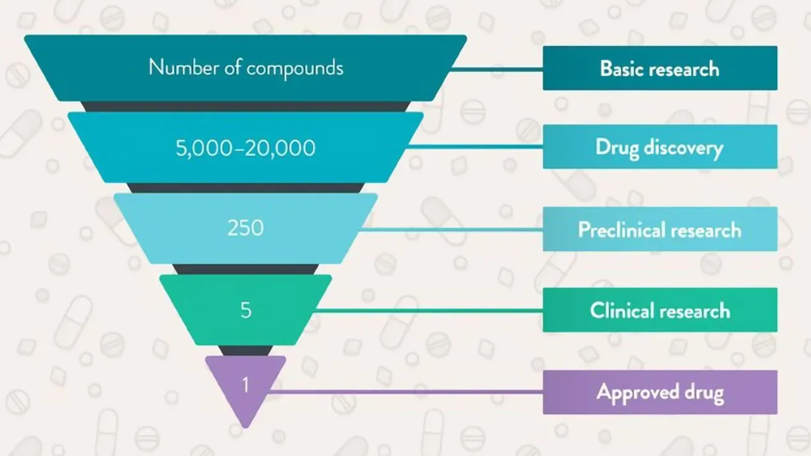

Slide 4
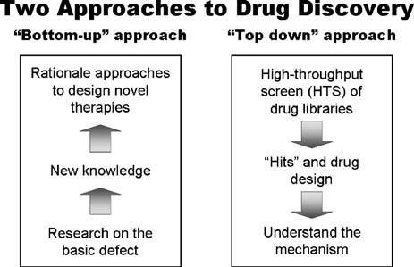
Computationally more friendly
www..researchgate.net%2Ffigure%2FSchematic-representation-of-two-possible-approaches-to-drug-discovery-namely-the_fig2_7019240&psig=AOvVaw1XHsMIgC2PAjGfURbhe6hG&ust=1680227681073000&source=images&cd=vfe&ved=0CBAQjRxqFwoTCPDcvYLGgv4CFQAAAAAdAAAAABA1

Slide 5
needle in a haystack
https://www.science.org/doi/10.1126/science.aat2663
Notes:
HTVS starts with an initial library of molecules built on the basis of researchers’ intuition, which narrows down the pool of possible candidate molecules to a tractable range of a thousand to a million. Initial candidates are filtered on the basis of focused targets such as ease of synthesis, solubility, toxicity, stability, activity, and selectivity. Molecules are also filtered by expert opinion, eventually considered as potential lead compounds for organic synthesis. Successful motifs and substructures are further incorporated in future cycles to further optimize functionality.

Slide 6
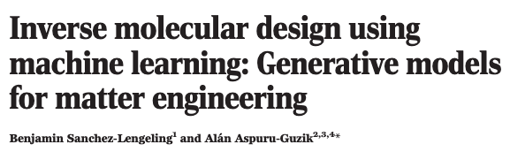
Material design Challenges
Brain storming
Sanchez-Lengeling et al., Science361, 360–365 (2018)

Slide 7
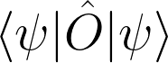



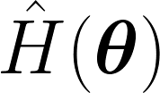
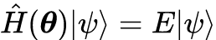
INVERSE DESIGN
obstacles of direct design
Amount data to generalize a phenomenon
Resources
Existing bias of models
observable
optimization
machine leaning
model
How can ML’s tools help us in material science?
Notes:
metaphor (spherical cows)

Slide 8
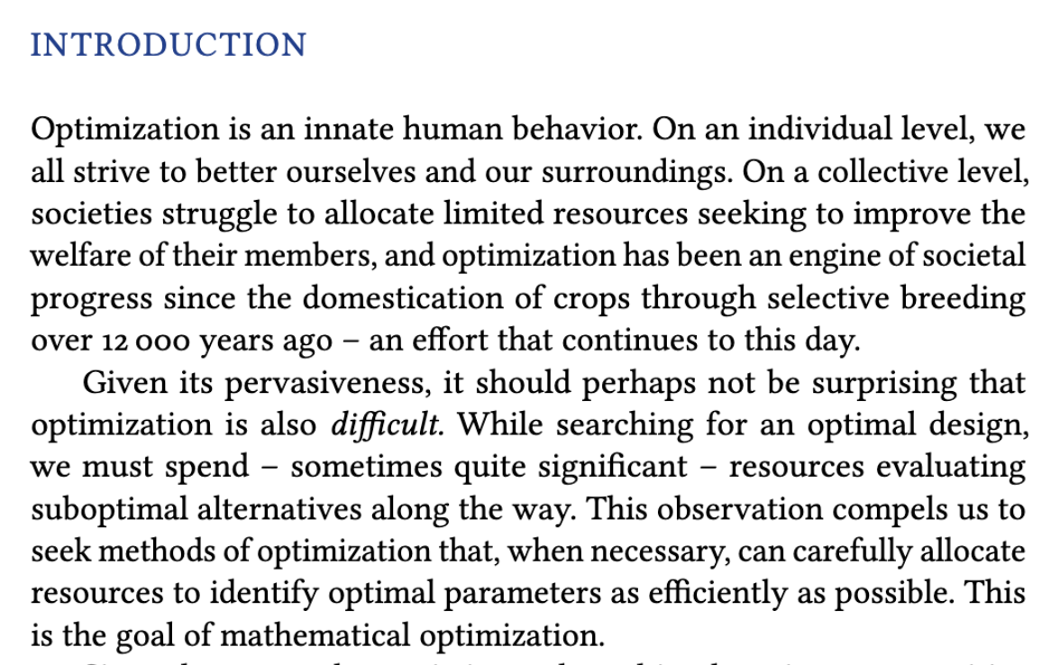
(book) R. Garnett, Bayesian Optimization (2021)

Slide 9
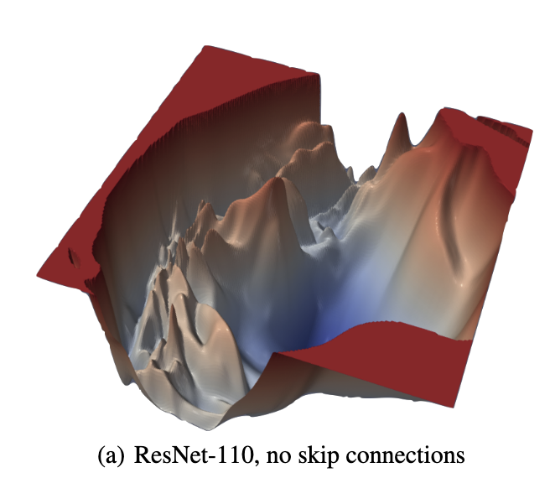
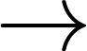

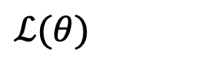
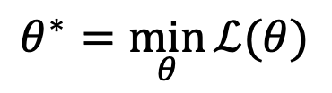
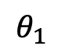
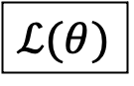
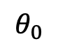
optimization
$ℒ(θ)$
Best model:
$$θ^{∗}=\min_{θ}{ℒ(θ)}$$
observable
optimization
$$θ_{1}$$
$ℒ(θ)$
$$θ_{0}$$
Hao Li et al. (2019)
model
$ℒ(θ)$ Optimality of $θ$
Noisy → Experiments
Expensive → Time or resources
Black-box → No gradients
Numerical routines → Computer simulations
Robust optimization algorithms!
Notes:
One option to search through the space of models is to think of it as an optimization problem, where the best model is the one with the highest accuracy or similarity to a desired property.
To solve this problem one most take into account some details, for example
is the data noisy, meaning it comes from an experiment,
what is our budget to solve the problem, (meaning we can’t brute force search for the answer as each iteration cost a great amount of time or resources)
Do we have some sort of oracle functions where only one at the time evaluation is doable
Numerical routes where gradients are available.
All these constrains dictate the optimal search algorithm that should be deployed to tackle such problems

Slide 10
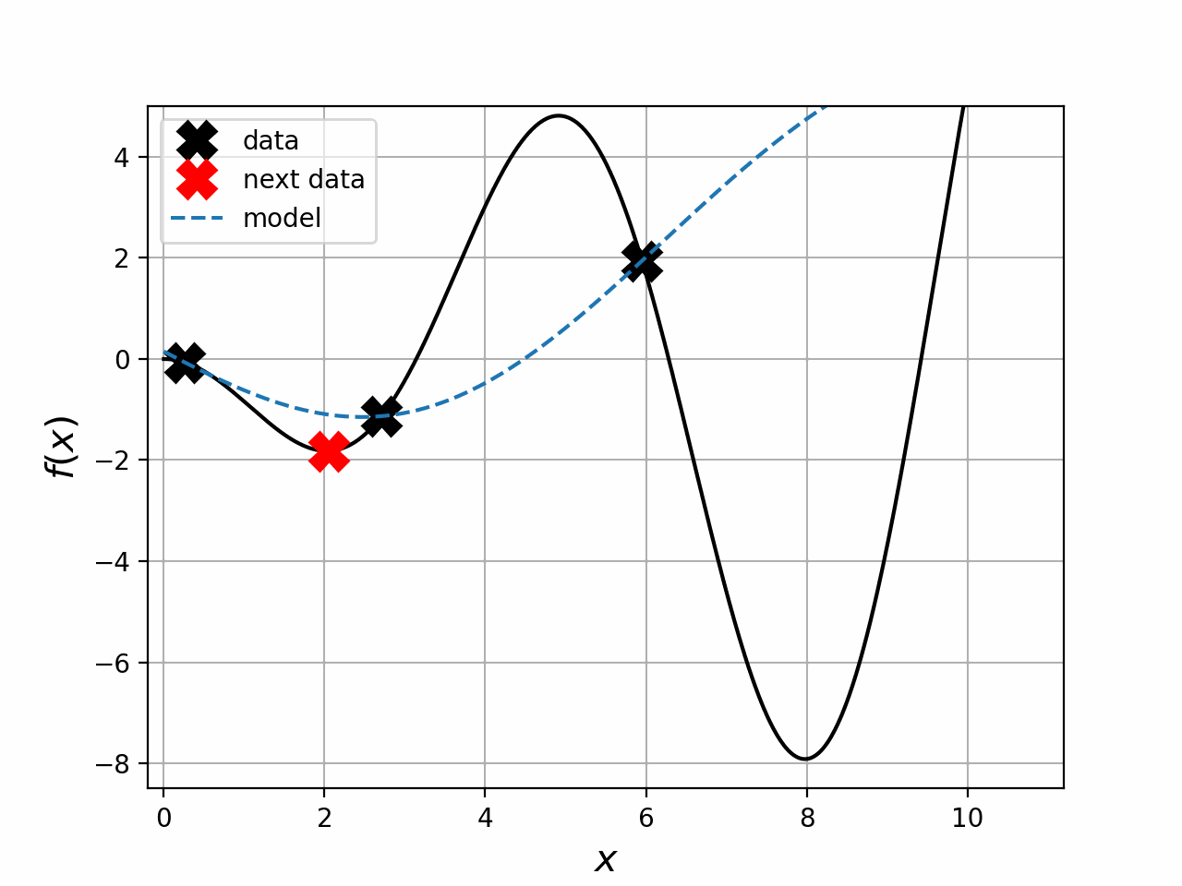
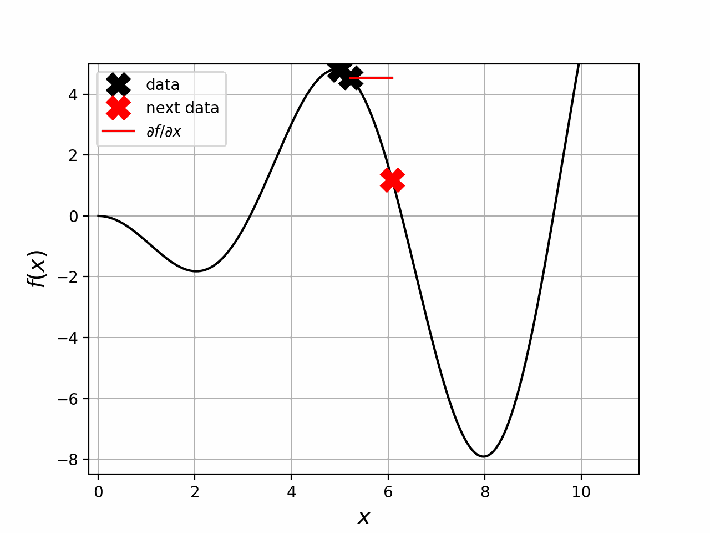
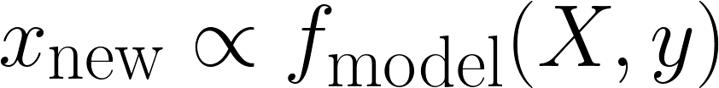
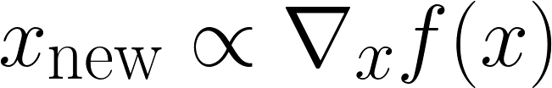
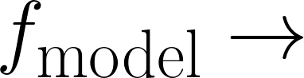
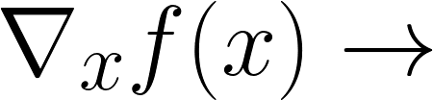
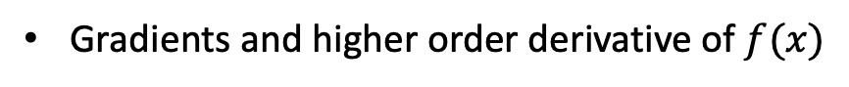
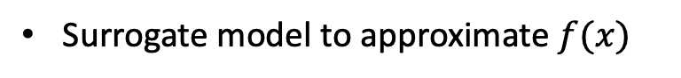
Optimization algorithms
Sampling:
Gradient:
Surrogate model to approximate $f(x)$
Gradients and higher order derivative of $f(x)$
Bayesian optimization
Differentiable programming
Notes:
There are two main frameworks for optimization,
Sampling
gradient
For sampling, one uses a a model that tries to mimic the landscape of the optimization process and through an iterative manner we search for the minimum
On the other hand, gradient methods used the gradient as the informational guidance to search for the minimum.
First, I will present some of my research where we used Bayes Opt to optimize physical models, and in the second part of my talk I will briefly introduce differentiable programming, a tool that could allow us the efficient computation of of gradients in in silico simulations.

Slide 11
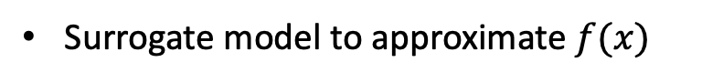
Genetic Algorithms
Sampling:
The genetic algorithm is a method for solving both constrained and unconstrained optimization problems that is based on natural selection, the process that drives biological evolution.
is a model that proposed new points based
on a dictionary of operations
Surrogate model to approximate $f(x)$
Bayesian optimization
https://www.youtube.com/watch?v=EOaPb9wrgDY

Slide 12
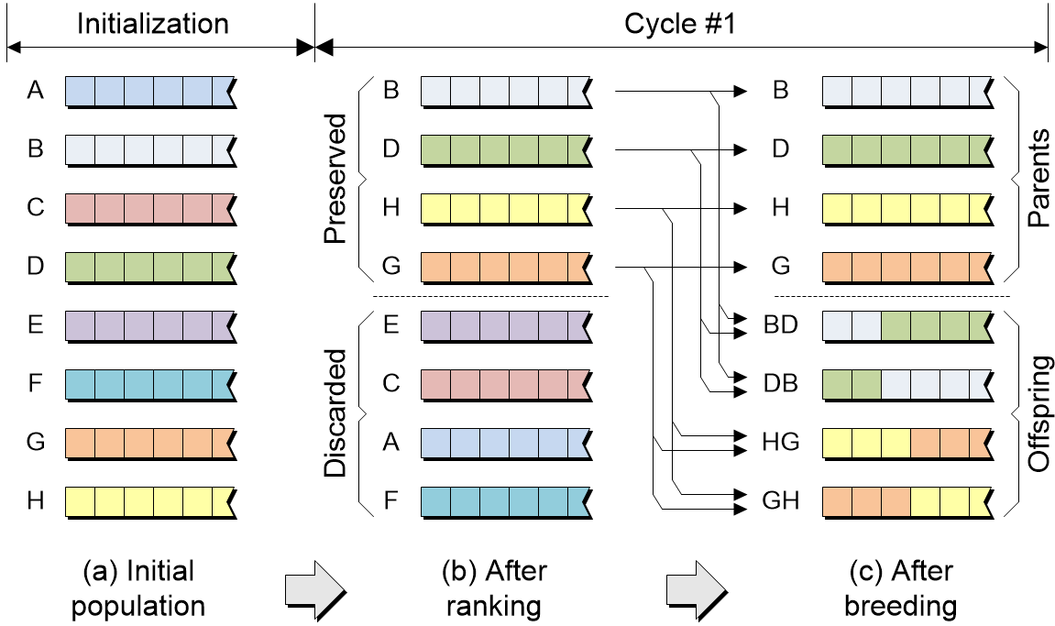
Fitness function

Slide 13
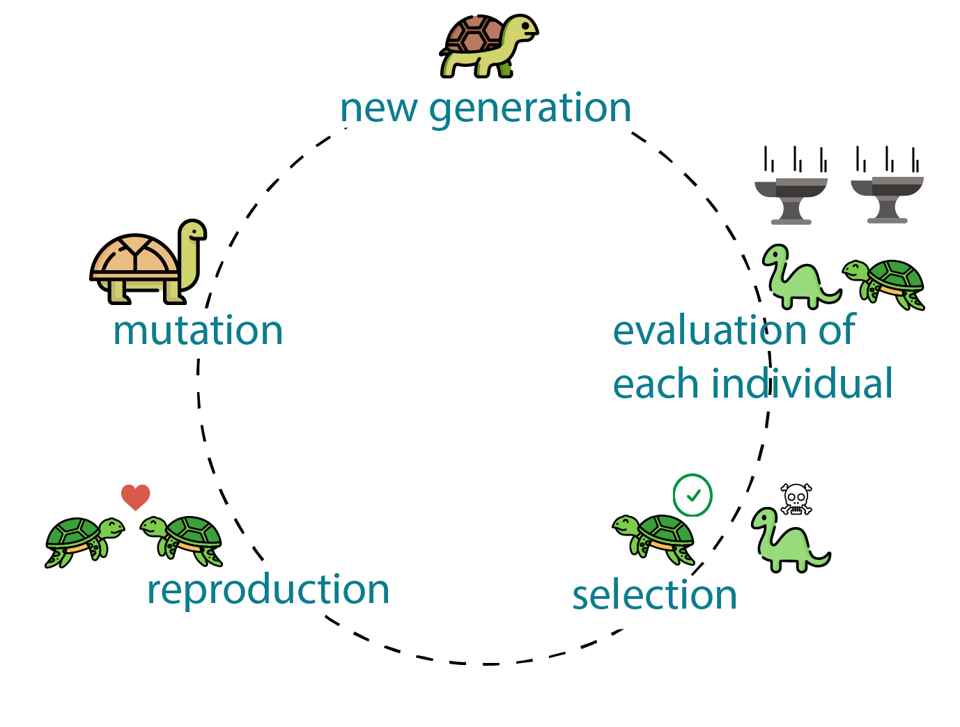
https://www.generativedesign.org/02-deeper-dive/02-04_genetic-algorithms/02-04-01_what-is-a-genetic-algorithm

Slide 14
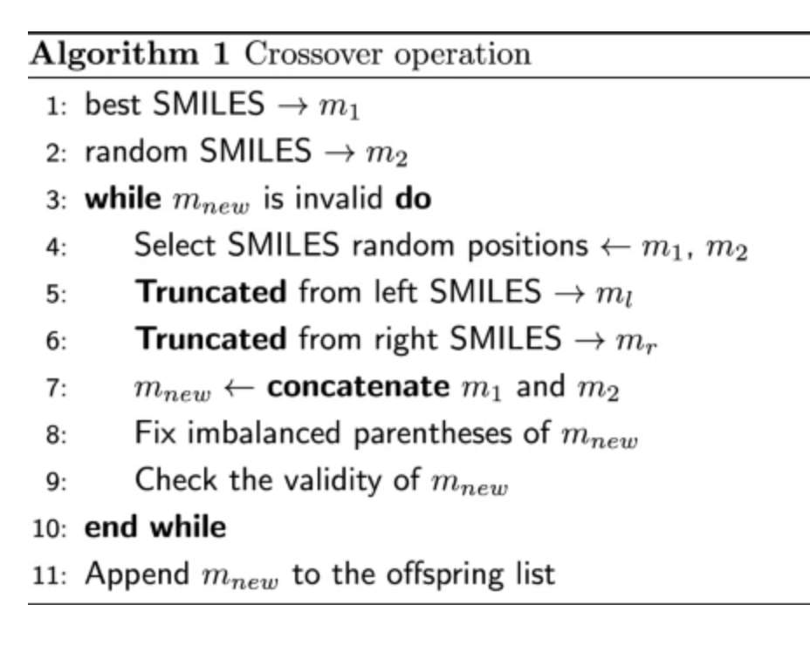
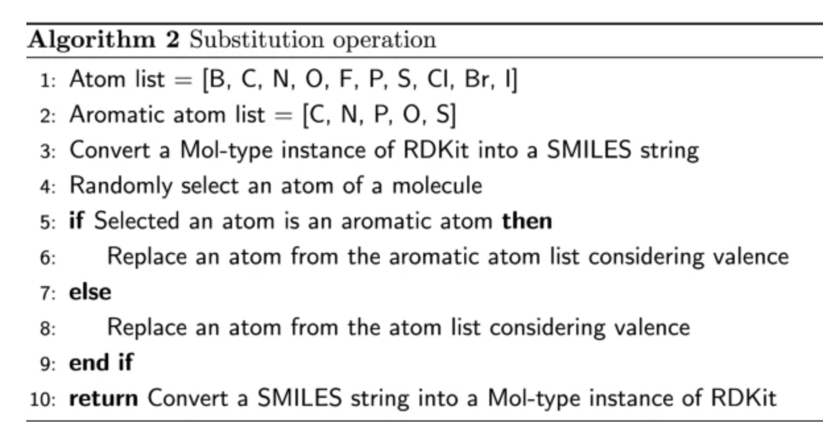
J Cheminform 12, 55 (2020).

Slide 15
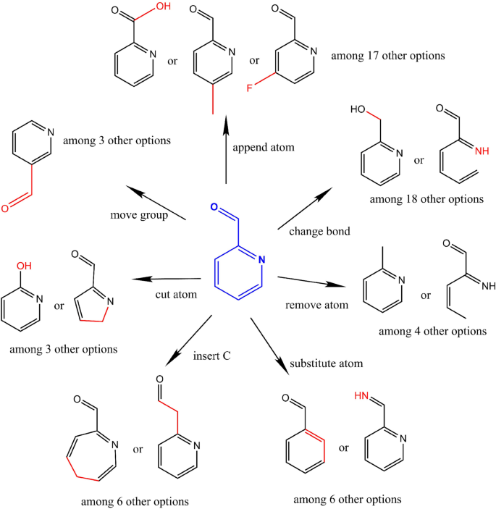
J Cheminform 12, 55 (2020).

Slide 16
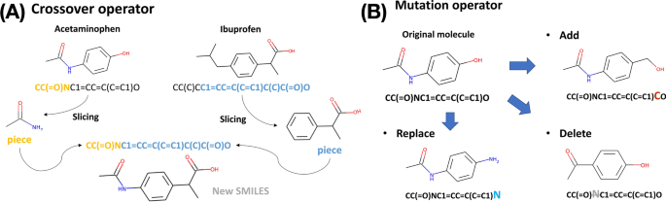
Dictionary of operations for SMILES

Slide 17
Fitness function
The fitness function guides the sampling of genetic algorithms.
Similar to the acquisition function of Bayesian Optimization.
→ Property of interest
→ Constrains
→ Weighing factor
J Cheminform 13, 24 (2021)

Slide 19
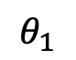
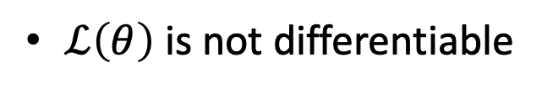
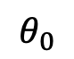
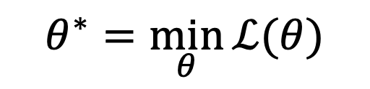

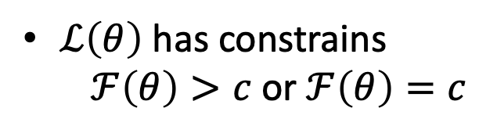
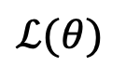
When to use GA
$$θ^{∗}=\min_{θ}{ℒ(θ)}$$
$ℒ(θ)$
$ℒ\left(θ\right)$ is not differentiable
$ℒ\left(θ\right)$ has constrains
$ℱ\left(θ\right)>c$or $ℱ\left(θ\right)=c$
$$θ_{1}$$
$$θ_{0}$$
$θ$ is not continues

Slide 21
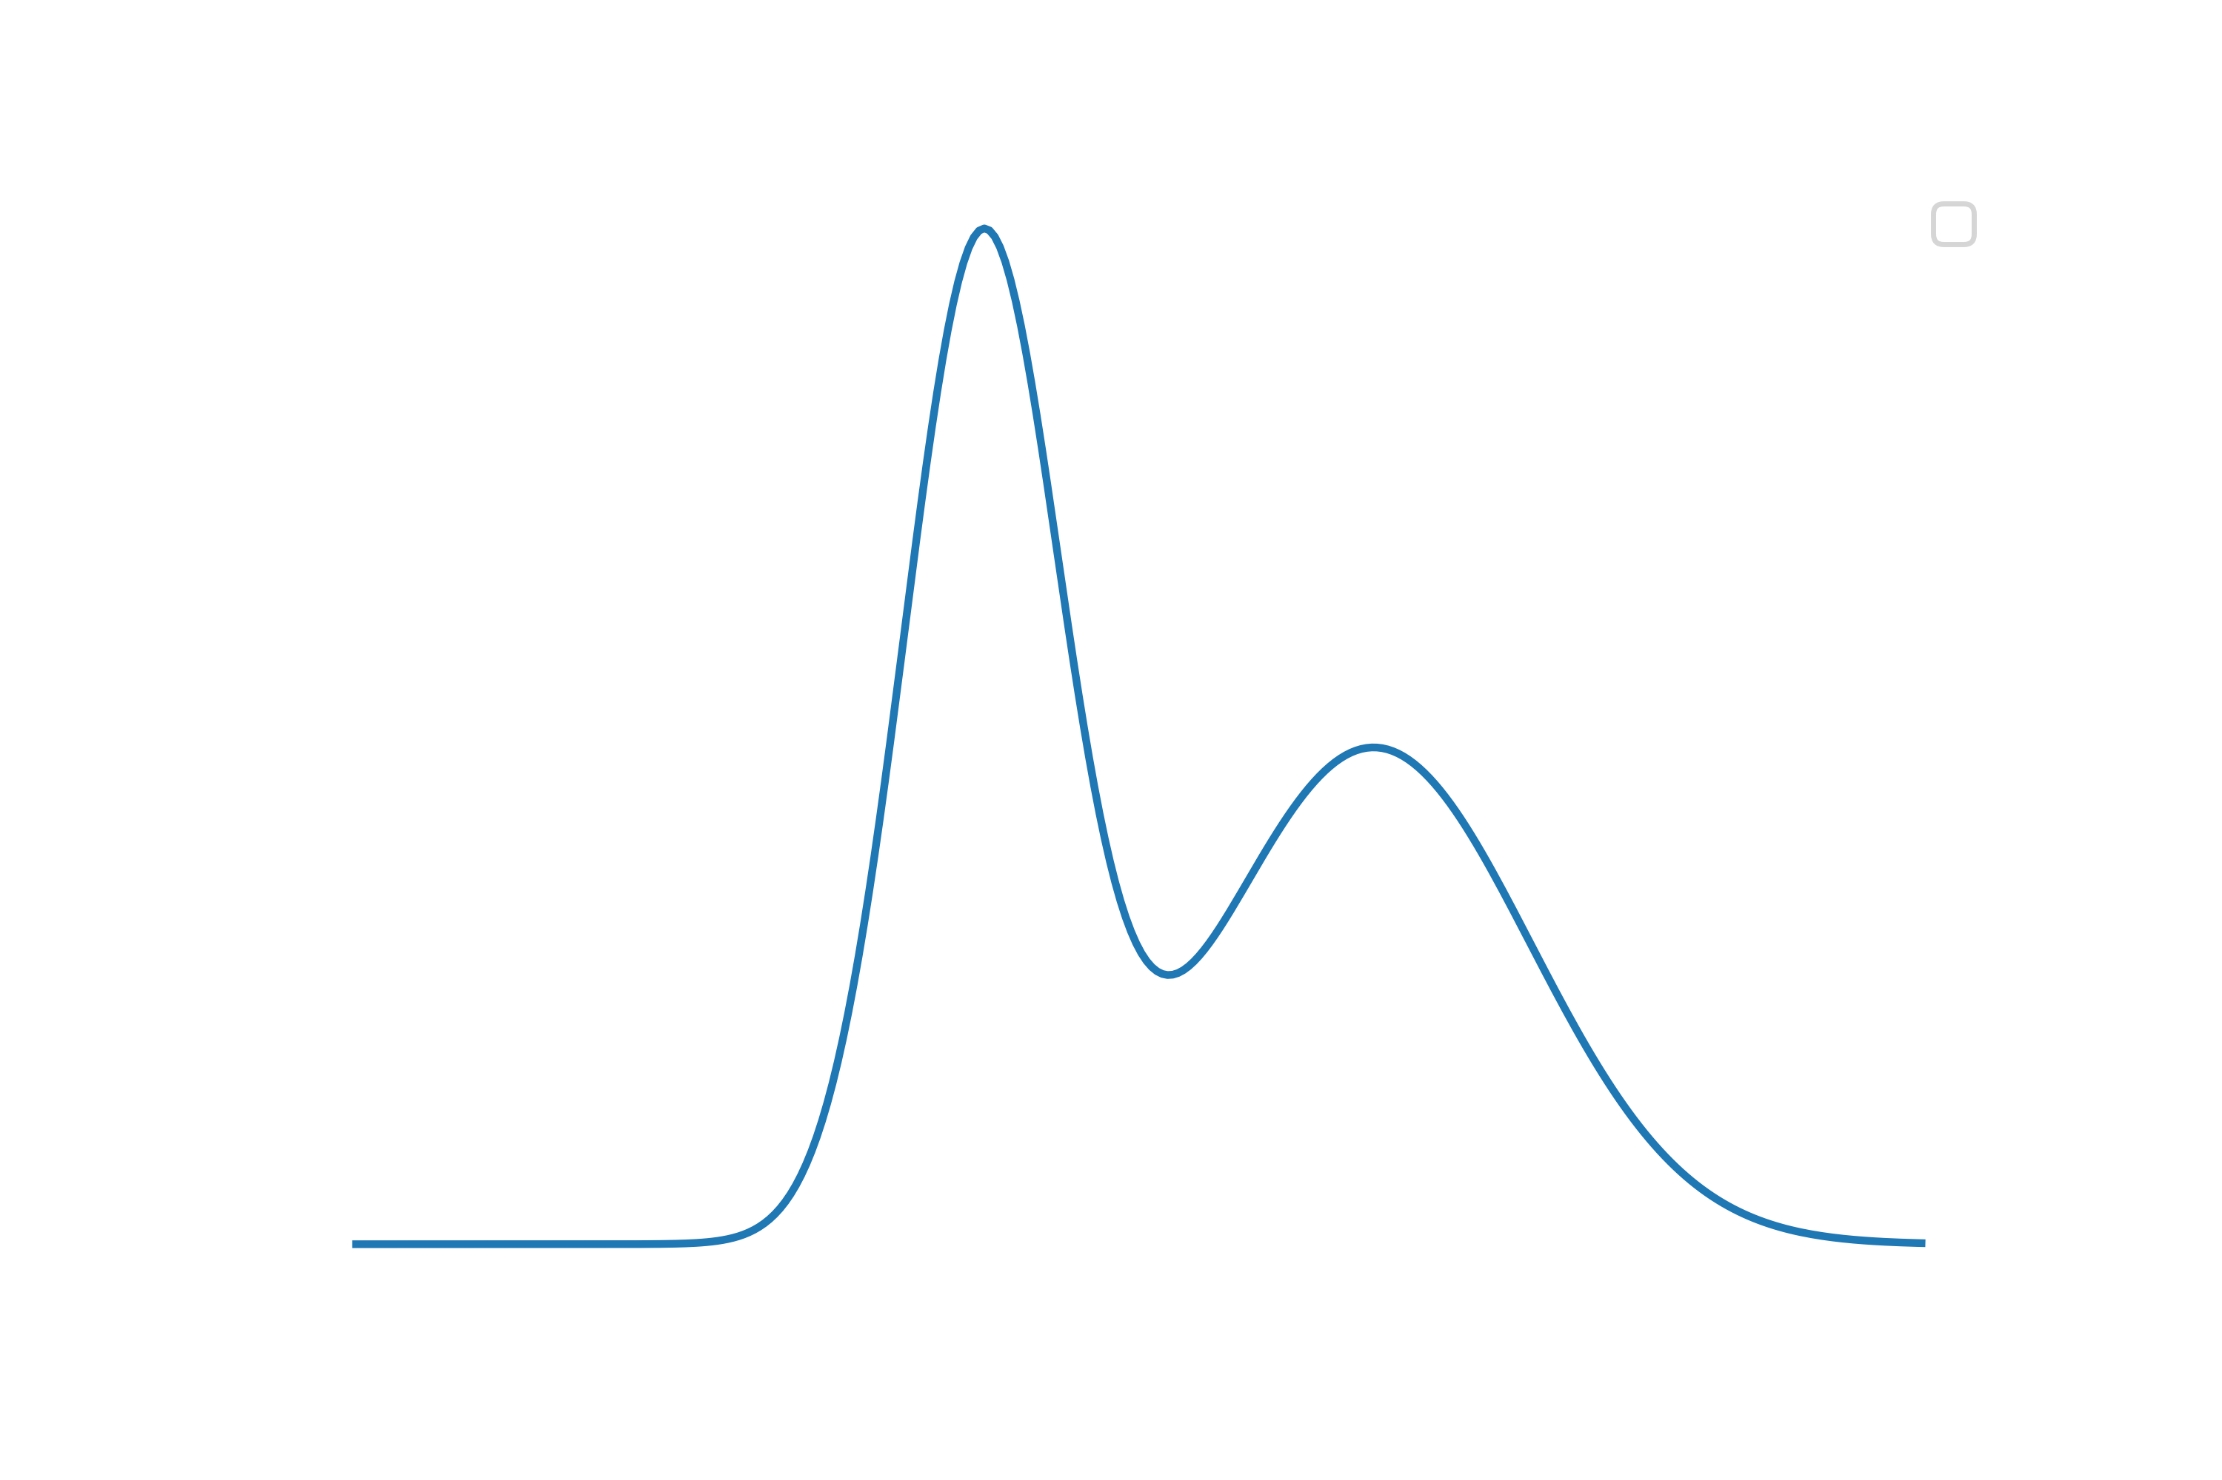
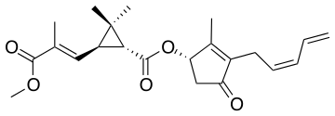
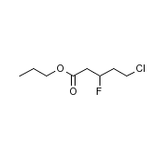
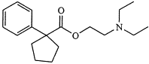
(current trend) Probabilistic ML
Distribution of molecules
https://towardsdatascience.com/denoising-diffusion-generative-models-in-graph-ml-c496af5811c5

Slide 22
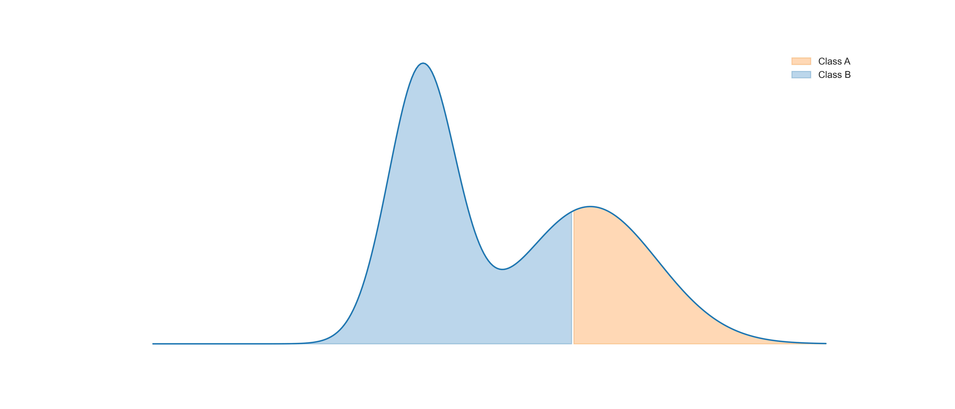
(current trend) Probabilistic ML
Distribution of molecules
https://towardsdatascience.com/denoising-diffusion-generative-models-in-graph-ml-c496af5811c5

Slide 23
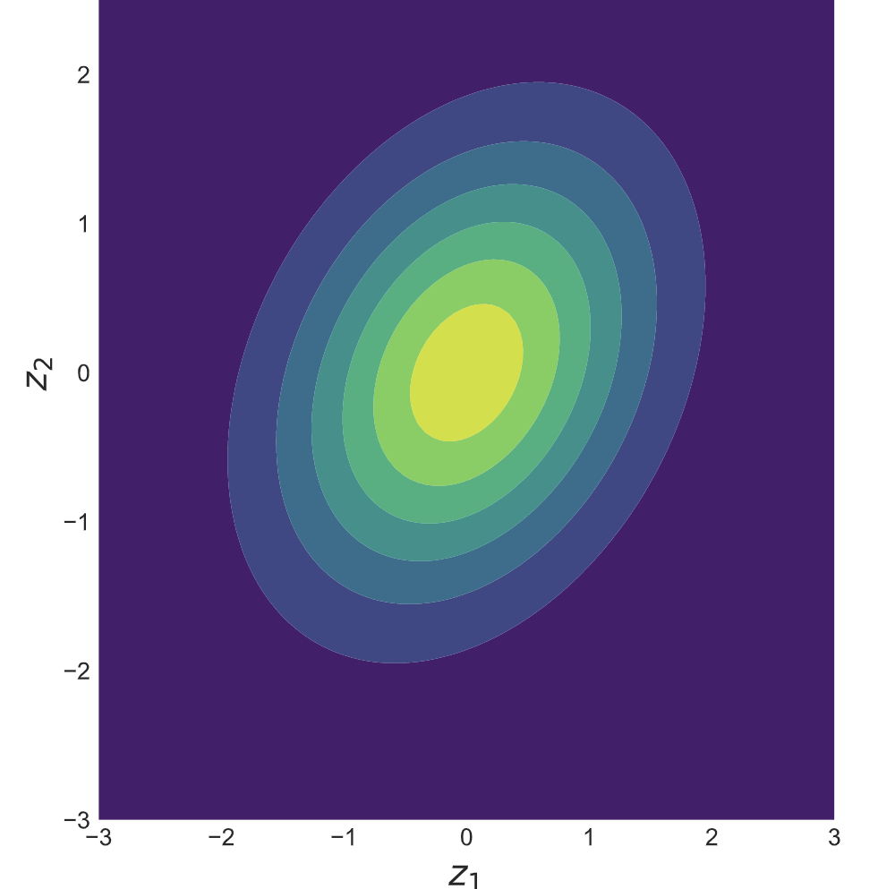
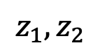
How can we learn molecular distributions?
$$z_{1},z_{2}$$
NN
NN
Automatic Chemical Design Using a Data-Driven Continuous Representation of Molecules
ACS Cent. Sci., 4, 2, 268 (2018).

Slide 24
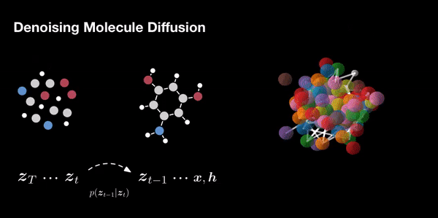

Slide 26

Carlos A. Martins Jr
Department of Materials Physics and Mechanics
Institute of Physics
University of São Paulo
camjjr.cm@usp.br

Slide 27
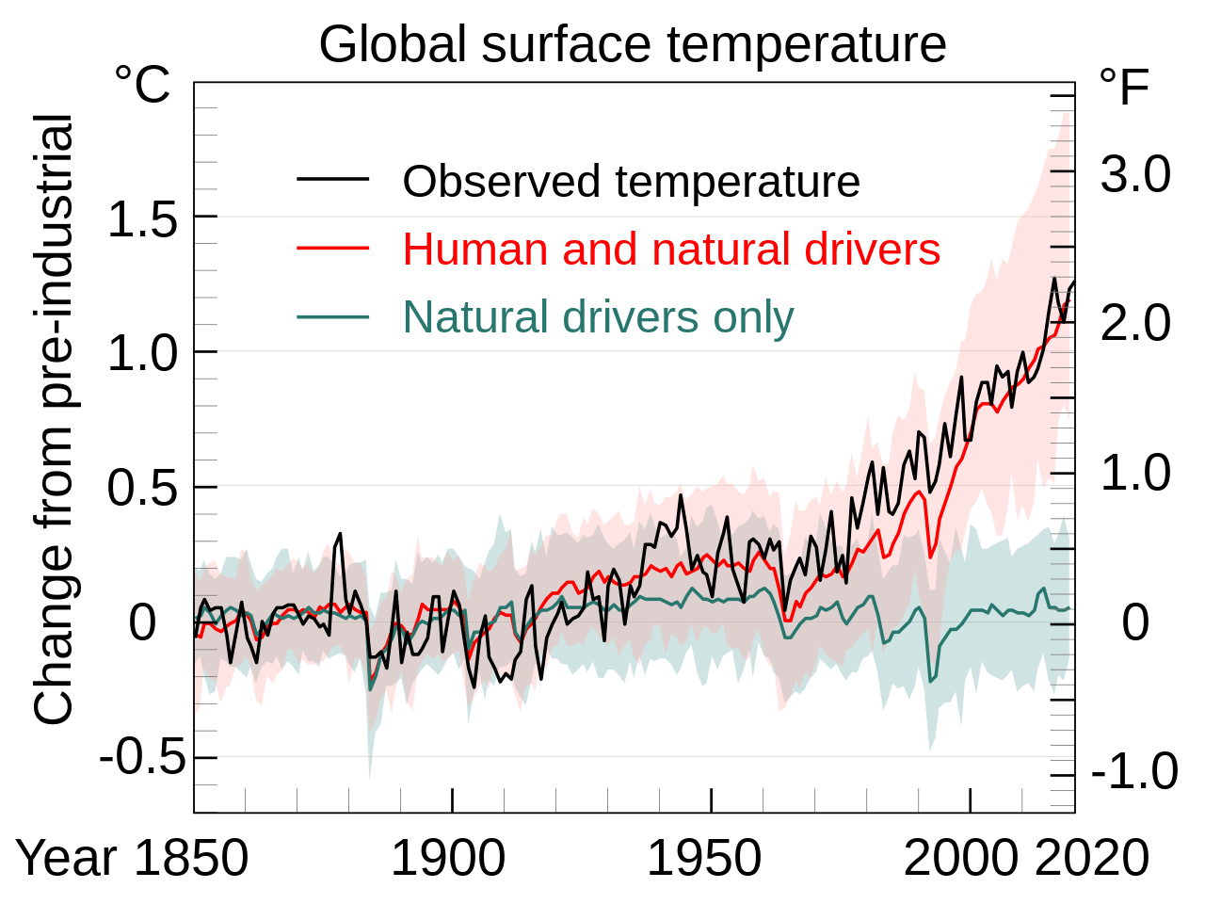
Climate Change
The warming should not exceed 1.5ºC (Currently, it is ~1.2 ºC)
There is a need to cut by half the emission by 2030 and reach a carbon-neutral economy by 2050

Slide 28
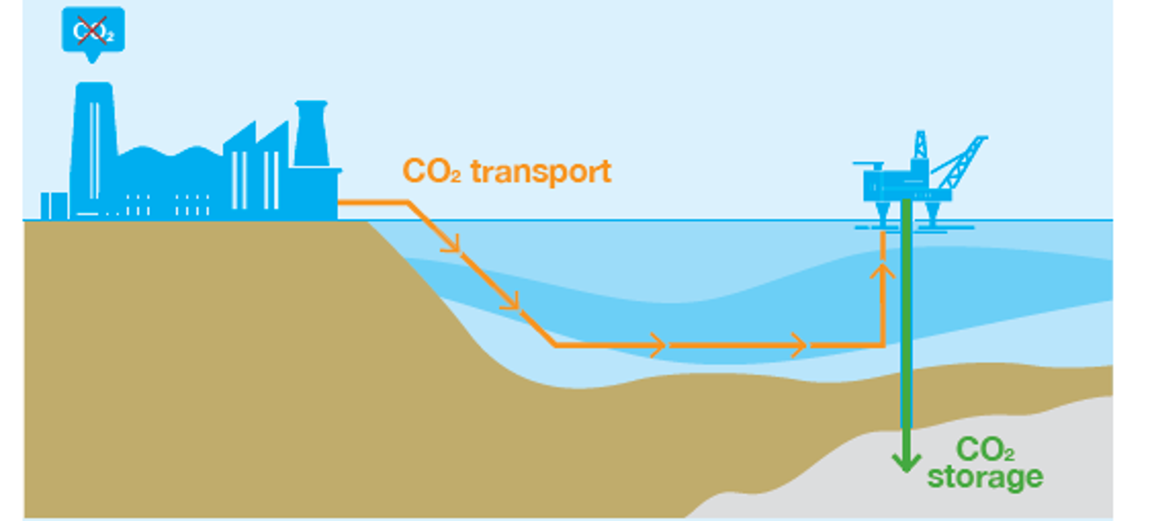
Carbon Capture and Storage
Capture the emitted carbon dioxide and storage it in geological facilities
There is a need to separate CO₂ from other gases in flue gas
N₂ is the main component of flue gas

Slide 29
Carbon Capture and Storage
To perform N₂/CO₂ separation, it is possible to use membranes
Ideally, it would allow the passage of only a species
It is possible to control the selectivity by controlling the adsorption properties

Slide 30
Fitness function
The fitness function guides the sampling of genetic algorithms.
Similar to the acquisition function of Bayesian Optimization.
→ Property of interest
→ Constrains
→ Weighing factor
J Cheminform 13, 24 (2021)
Notes:
Is the fitness function unique?

Slide 31
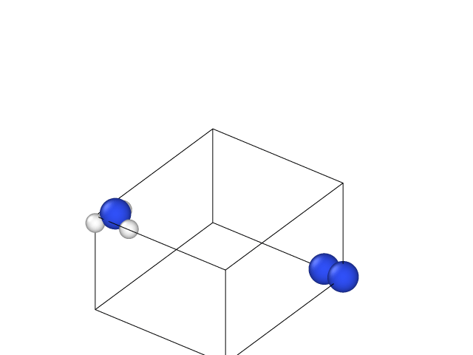
Find the molecule with the highest affinity to N2 for storage
How can we estimate the affinity?
How do we compute?

Slide 32
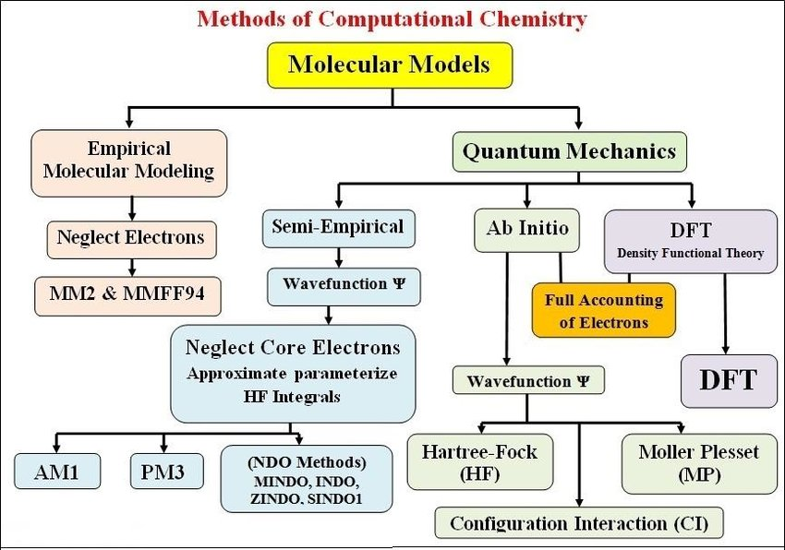
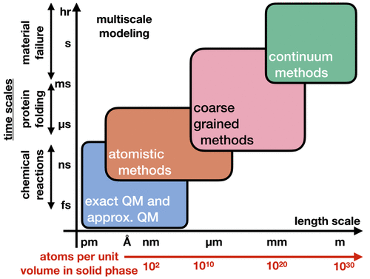
Rodrigo’s road map of computational chemistry
What information should we consider?
https://doi.org/10.1021/acs.chemrev.1c00107
https://www.researchgate.net/publication/343017500_A_Simple_Approach_to_Quantum_Chemistry

Slide 33
Find the molecule with the highest affinity to N2 for storage
How can we describe affinity?
How do we compute ?

Slide 34
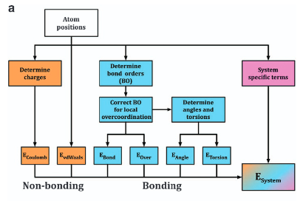
ReaxFF
Ebond is a continuous function of interatomic distance and describes the energy associated with forming bonds between atoms.
Eangle and Etors are the energies associated with three-body valence angle strain and four-body torsional angle strain.
Eover is an energy penalty preventing the over coordination of atoms, which is based on atomic valence rules.
ECoulomb and EvdWaals are electrostatic and dispersive contributions calculated between all atoms, regardless of connectivity and bond-order.
ESpecific represents system specific terms that are not generally included, unless required to capture properties particular to the system of interest.
https://pubs.acs.org/doi/suppl/10.1021/jp709896w/suppl_file/jp709896w-file004.pdf
Notes:
Eover -> a stiff energy penalty is applied if a carbon atom forms more than four bonds

Slide 35

EvoMol - Overview
An evolutionary algorithm to design molecules without the need of a known dataset.
One of the main advantages of using an evolutionary algorithm is the fact that it allows a smoother exploration of the chemical space.
Independent of the starting data
https://github.com/jules-leguy/EvoMol
https://doi.org/10.1186/s13321-020-00458-z

Slide 36
EvoMol - Graph Representation
Molecules might be represented using SMILES, SELFIES or graph representations
Evomol used a graph representation. However, they did not explain how the program gets obtains it (at least, it was not clear for me)
It performs some checks to validate a molecule. However, they discuss that sometimes it is not stable. For instance, they use DFT to check the stability

Slide 37

EvoMol
An evolutionary algorithm to design molecules

Slide 38
EvoMol
Evomol is sensible to the initial conditions. They run it a few times in the paper
Problems with the stability of the molecules (I have found it )
It possible to improve the search with machine learning
→ Molecular dynamics (ReaxFF) (LAMMPS)
→ Molecular stability

